Slide 1

FATF-RAG
Retrieval-Augmented Question Answering over the FATF Recommendations
End-to-end NLP application built on an LLM · domain: AML/CFT regulatory text
Group members: Riccardo Dondi, Maria Briones, Sayantan Mandal

Slide 2
PROBLEM FRAMING
Grounded, auditable answers from a 126-page legal text
Compliance teams repeatedly ask narrow questions of a long, dense regulatory document. A plain LLM answers from memory: it cannot cite a source and it invents plausible-but-wrong specifics — unacceptable in a regulatory setting.
We framed it as
Two domain requirements
Grounded QA
Verifiability over fluency. A confident wrong answer is worse than “not in the sources.” Citations and page traceability are first-class features.
Retrieve the passages that actually contain the answer
Answer only from them; refuse if not found
Cite the Recommendation number and page
Robustness to query style. Users mix conceptual questions with exact-term lookups (“Recommendation 16”, “USD/EUR 15 000”). Retrieval must handle both.
FATF-RAG · RAG on a domain-specific legal corpus
2

Slide 3
SYSTEM OVERVIEW
A thin, transparent pipeline — every stage is inspectable
PDF
corpus
›
Chunk
+ page tag
›
Embed
(MiniLM)
›
Retrieve
hybrid
›
Generate
local LLM
›
Cited
answer
Local & reproducible
Citable by construction
Fails safe
MiniLM embeddings + open-source generators. No API keys, runs offline.
Every chunk carries its page span and Recommendation/section label.
No model available → retrieval-only mode returns cited passages, never crashes.
FATF-RAG · RAG on a domain-specific legal corpus
3

Slide 4
WHY, NOT JUST WHAT
Design choices
Hybrid retrieval (dense + BM25)
Dense-only misses exact terms/IDs; on jargon-heavy legal text lexical signal is too valuable to drop.
Page-tagged chunking
Auditability is a feature: an answer is only useful if it can be checked against the page.
Local open-source models
No keys, no external calls, fully reproducible for the evaluator — and avoids vendor lock-in.
Thin stack (no LangChain)
A framework hides the retrieval mechanics we are graded on explaining.
Exact NumPy / flat FAISS
250 chunks: brute-force is instant; an approximate index adds complexity for no benefit.
FATF-RAG · RAG on a domain-specific legal corpus
4

Slide 5
WHY, NOT JUST WHAT
Design choices - the excluded
1 ·'Qwen3-Embedding-0.6B' embedding model.
2 · Purely dense or purely lexical (BM25) retrieval
Considerably heavier model increasing the hardware demand and processing times.
Inforcing a larger chunk on all-MiniLM is possible but was discarded as it increased the risk of quality loss.
In consequence we opted for chunks of 250 word size.
Dense captures meaning and paraphrase, but blurs exact terms.
BM25 nails exact terms but is blind to synonyms and rephrasing.
A hybrid (fusing both scores) recovers the documents either method alone would miss.

Slide 6
METHODOLOGY · QUALITATIVE
Qualitative methodology — what we vary and why
Chunking
Retrieval
Generation
page — one page per chunk
paragraph — word windows
paragraph + overlap (50w)
recursive char windows (prod.)
dense (semantic, MiniLM)
BM25 (lexical, exact terms)
hybrid (normalised fusion, α)
Flan-T5 (instruction, seq2seq)
GPT-2 (causal baseline)
Llama via Ollama (optional)
FATF-RAG · RAG on a domain-specific legal corpus
5

Slide 7
METHODOLOGY · QUANTITATIVE
Quantitative methodology — two independent evaluations
1 · Retrieval evaluation
2 · Answer evaluation
Did we find the right text?
Was the generated answer right?
15 hand-built questions with gold pages located manually in the PDF
Relevant = retrieved chunk's page span ∩ gold pages
Metrics: Recall@k (hit rate), MRR, Precision@k
Ablation across retriever type and chunk size
8 QA pairs with short expected answers
9 scenarios = 3 chunking strategies × 3 generators
Score: factual substring match (expected ⊂ output)
End-to-end: retrieve → augment → generate → check → manual validation
FATF-RAG · RAG on a domain-specific legal corpus
6

Slide 8
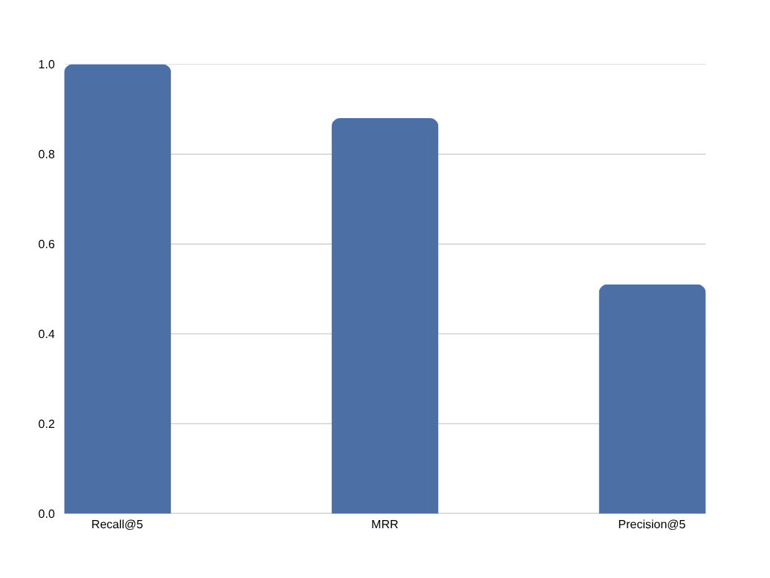
RESULTS · RETRIEVAL
Retrieval results — BM25 is a strong baseline here
How we read it
Every question retrieves a gold page in the top-5; the first hit is correct on 11/15 (MRR 0.88).
The corpus is small and uses consistent terminology, so exact match is hard to beat — reporting only a dense number would overstate the need for embeddings.
Dense / hybrid earn their keep on paraphrased queries; our in-vocabulary test set under-tests that gap (see limitations).
Precision@5 ≈ 0.5 is expected: most answers live on a single page. Recall and MRR are the metrics that matter for a QA front-end that shows 5 sources.
FATF-RAG · RAG on a domain-specific legal corpus
7

Slide 9
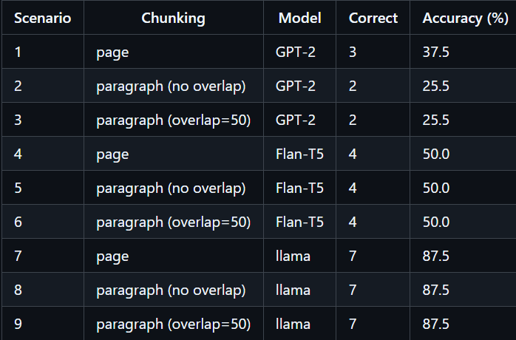
RESULTS · SCENARIOS
Answer results — chunking and the reader matter most
Findings
Chunking doesn't have a vissible meaningfull effect. ‘page’ strategy performed reasonably well when compared to small chunking, even giving better result for the case of GPT-2.
Reader type > size. the seq2seq model (Flan-T5) beat the causal GPT-2, but both models are beaten by Llama. It consistantly provides correct answers and guides its source so it can be tracked back.
FATF-RAG · RAG on a domain-specific legal corpus
8

Slide 10
INTERPRETATION & LIMITATIONS
What we conclude — and where we are honest
Takeaways
Limitations
Retrieval quality + an instruction-following reader matter more than model size.
Page-level citations make every answer auditable — the core requirement for compliance use.
On a small, consistent corpus, BM25 is a strong baseline; hybrid adds robustness to paraphrase.
Test sets are small and group-authored — a sanity check, not a benchmark.
Page-level relevance is coarse; substring match under-counts paraphrased-correct answers.
Questions are in-vocabulary, which flatters BM25.
Answer faithfulness is not yet scored automatically.
FATF-RAG · RAG on a domain-specific legal corpus
9

Slide 11
Reproducible, local, and auditable
Deliverables. Git repo (source, requirements, README), reproducible notebook, CLI and Streamlit entry-points, and this deck.
Future work.
Test the model on different languages (ex. Italian and spanish).
Modify pipeline to integrate more than 1 document as source.
Explore new embedding models compatible with a loval environment and acceptable time responses.
AI usage disclosure
Claude (Anthropic): was a boilerplate for the retrieval pipeline modules (FAISS/BM25 wrappers, the Streamlit and CLI scaffolding), debugging the generation step (the GPT-2 1024-token IndexError), researching and comparing embedding-model context windows and multilingual support, refactoring the notebook into reusable functions and pipeline structure
github.com/[your-org]/fatf-rag

